Slide 1
DRAWING
Get out your Color Wheel and Color Theory Vocab worksheets. Take a seat and prepare for discussion.
Today we’re going to begin to answer the following questions: How are the choices I make as an artist affecting my viewer? How can I use color more effectively in my works?
By using and colors.
WARM
COOL

Slide 2
Write down a few things you notice about this picture. Think about color schemes, elements of art, what does it remind you of, etc.
WARM
Warm colors come forward, or protrude.
COOL
Cool colors recede, or appear to be in the background.
The artist places warm and cool colors next to each other to create depth.
WARM → COOL

Slide 3
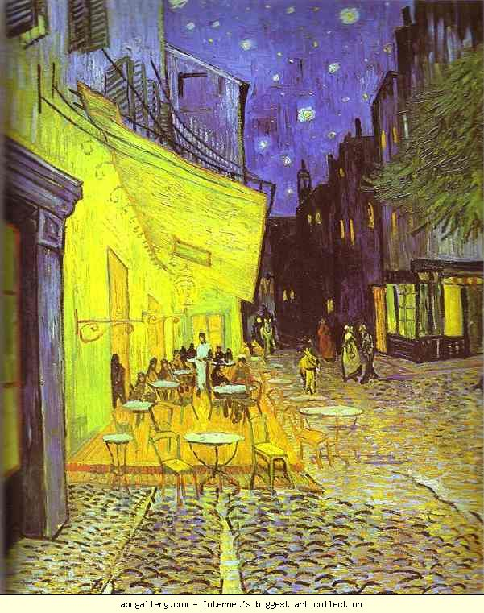
Vincent van Gogh,
Café Terrace at Night
What do we know is closest to us? How does the artist use color to bring the midsection closer to us?

Slide 4
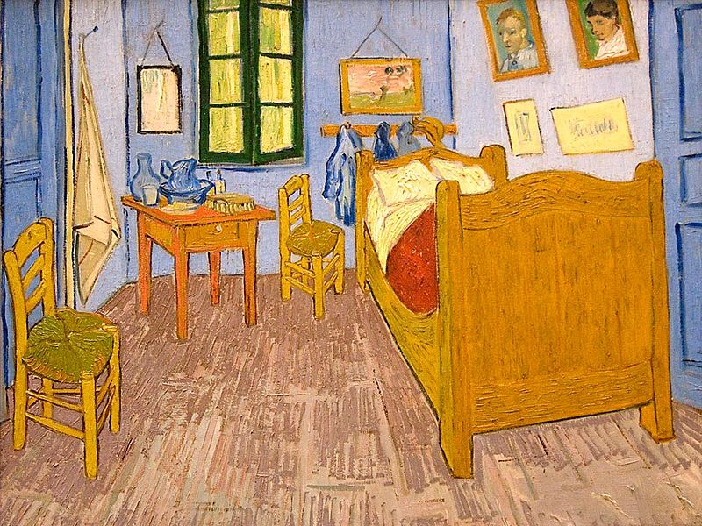
How does the artist use warm and cool colors to help portray depth in this painting? *Hint* Compare the foreground vs. the background. Think about what feels closest to us, furthest away- Why?
What color scheme did the artist used?
Vincent van Gogh,
Bedroom in Arles

Slide 5
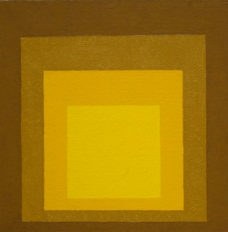
Josef Albers
Which is receding (away from us) and protruding (towards us)?
What color schemes are used by the artist in each of these (they are both different!)

