Slide 1
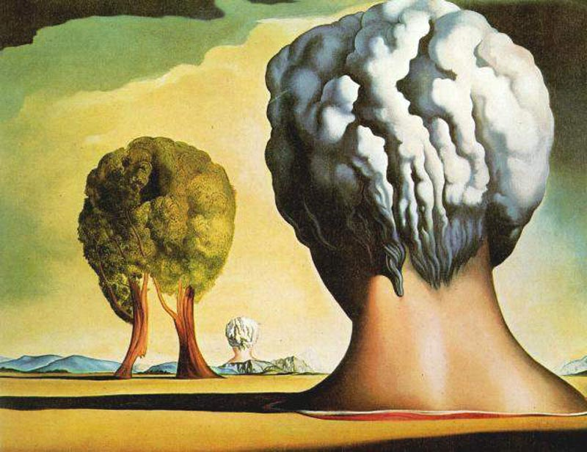
Surrealism

Slide 2
Salvador Dali
Persistence of Memory

Slide 3
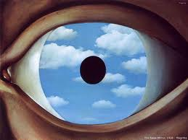
Rene Magritté
False Mirror

Slide 4
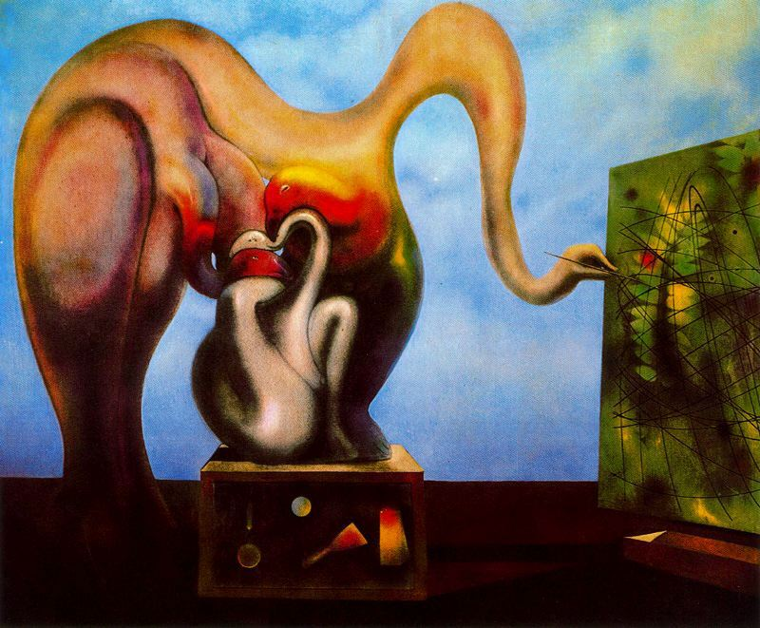
Max Ernst
Surrealism and Painting

Slide 5
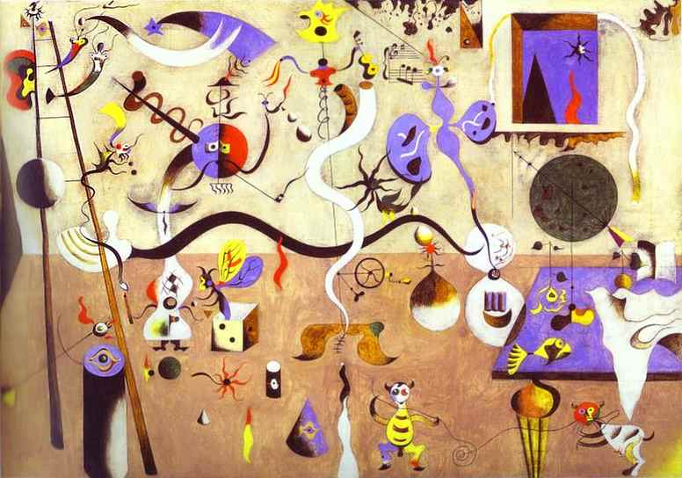
Joan Mirό
Harlequin's Carnival

Slide 6
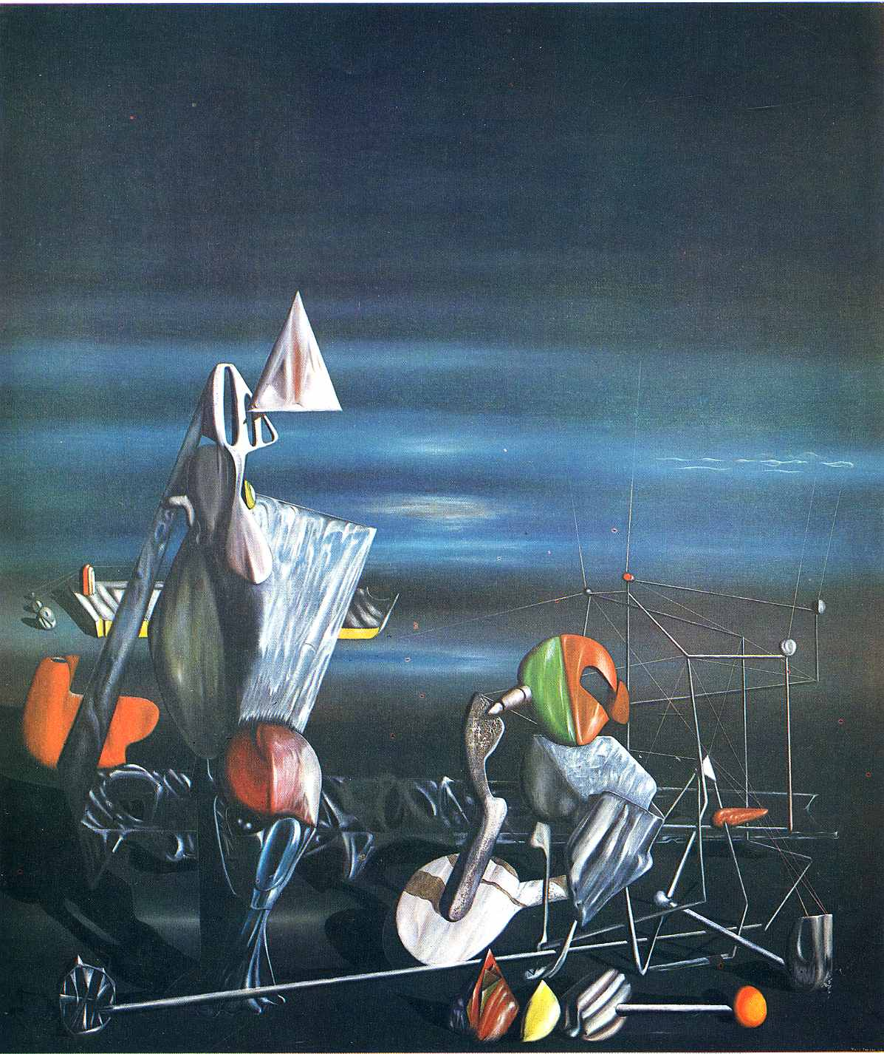
Yves Tanguy
Slowly Towards the North

